Slide 1
Callaway Crain
Data Science Capstone Progress

Slide 2
Data Set
Cybersecurity Breaches CSV – Dataset was chosen from Kaggle. This set has 14 columns and 1000 Rows. Each row representing aunique cybersecurity breach.

Slide 3
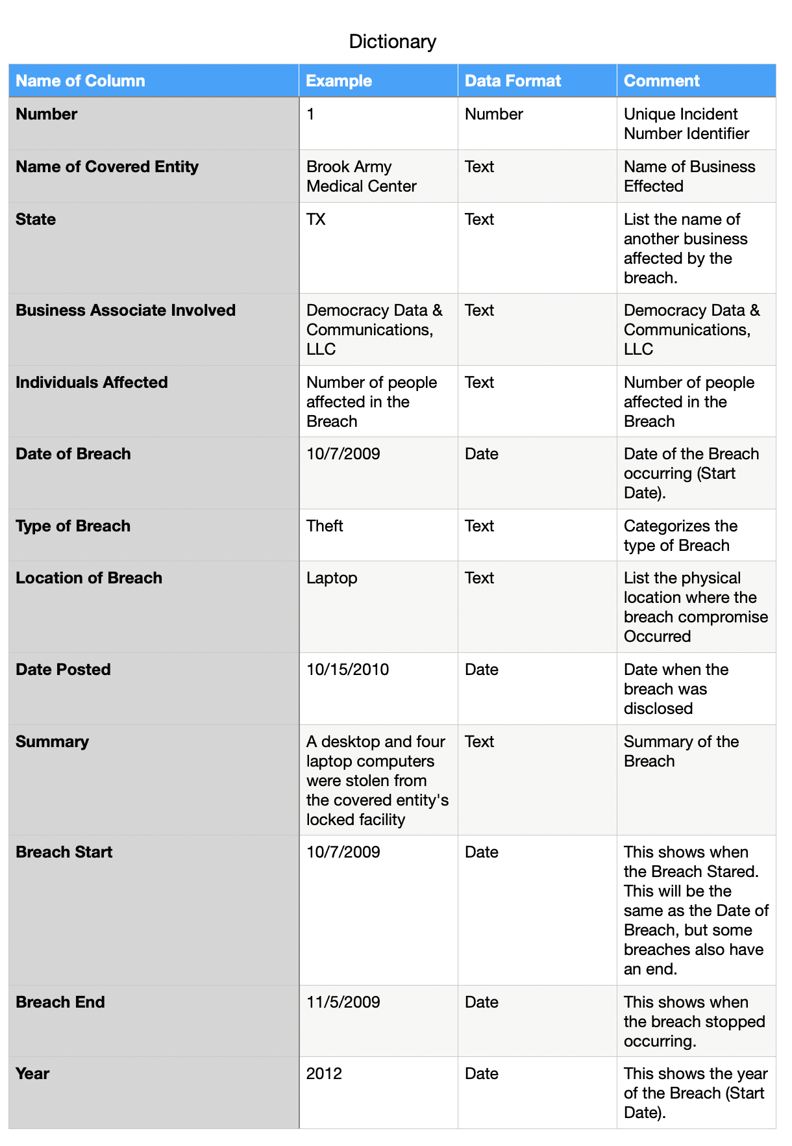

Slide 4
Target Audience
Executive - conclusion heavy, with some details

Slide 5
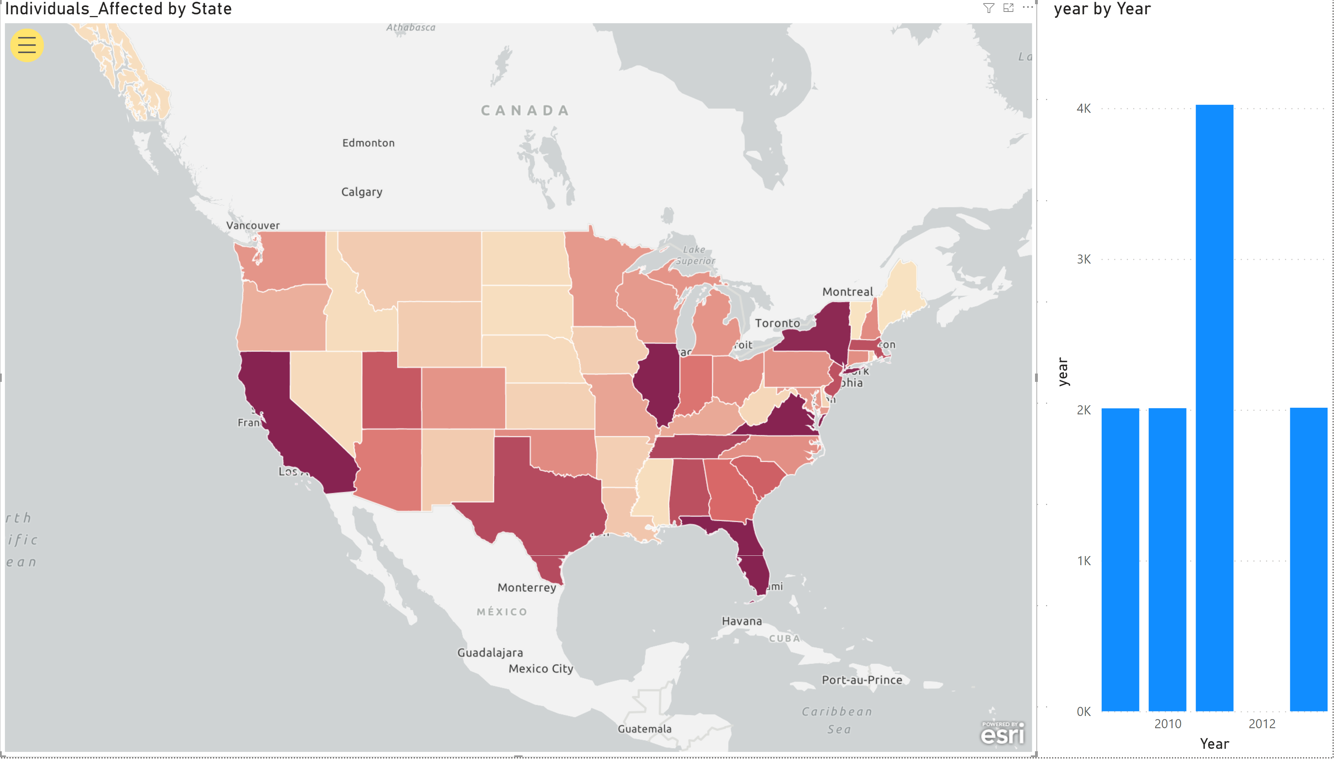
Level 1 & 2

Slide 6
Moving Forward
Data needs further cleaning.
Build new column from Location of breach. Make this column to categorize the breach location, by domain of IT infrastructure (LAN, Workstation, USER, Remote Access...etc).
Look for modeling related to Users affected and domain of IT infrastructure.
Treat the “Business Associates Involved” as a 1 or 0 output.

